Slide 1
Hand-Detection
Quintin Nguyen, Akhil Lal and Matthew Cho

Slide 2
About Our Program - The Problem we are trying to solve
The Problem: Want to detect hand position and movement within a video.
We do this by using feature matching and SIFT point description.
This program and algorithm can be used in a variety of different applications

Slide 3
Assumptions
Camera position and background are must stay the same
Currently detects a maximum of 1 hand (left or right)

Slide 4
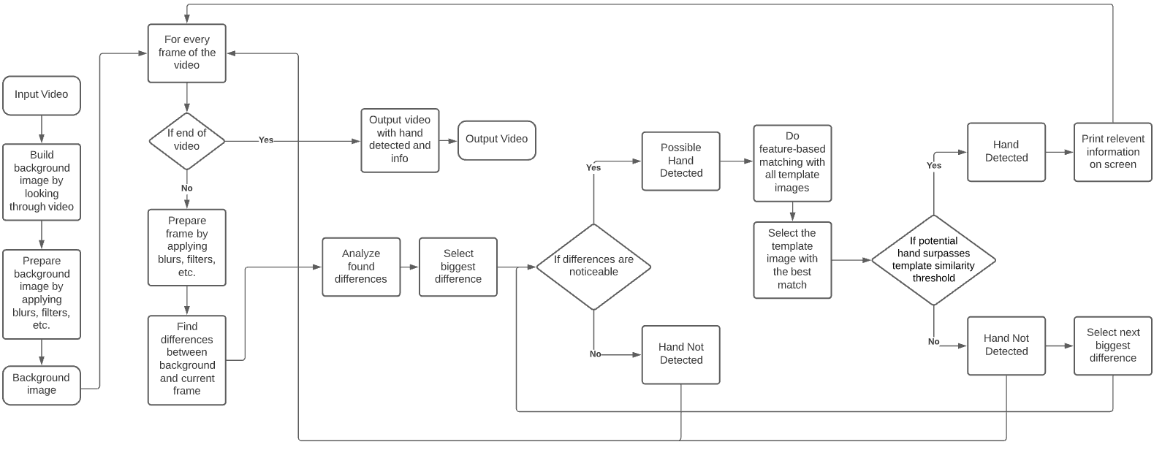
Flow Chart
Notes:
Find the background image
Prep the background image by blurring, increasing contrast, and greyscale
For every frame in video:
Prep the current frame by blurring and increasing contrast, and greyscale
Remove the background from the frame so that only the front object appears
Match template images’ keypoints against the object by searching only the object space for keypoints
Print relevant information to frame depending on if hand is detected

Slide 5
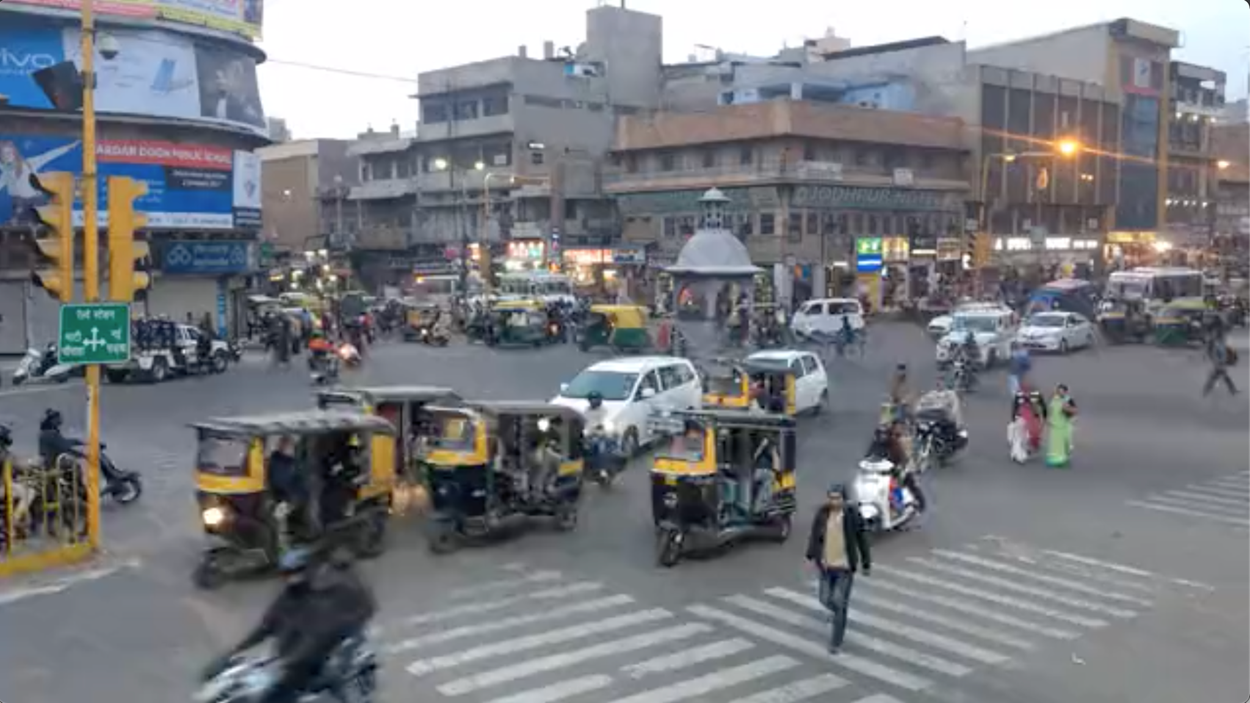
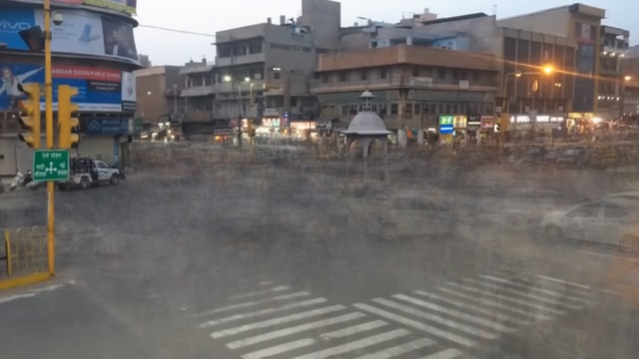
Extracting Background From Video
Do this by going through random frames of the video, and take the average of each pixel
Then form the background image using these pixels

Slide 6
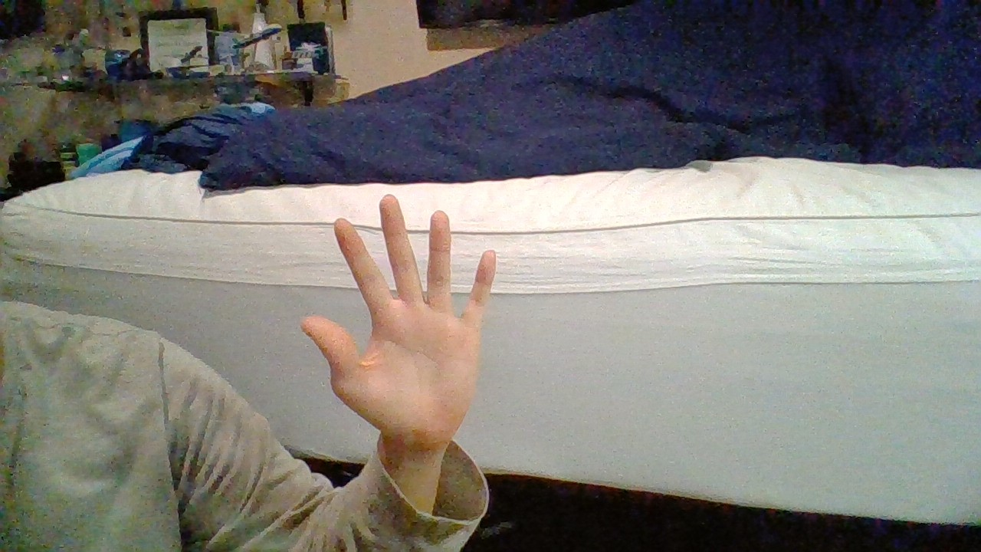
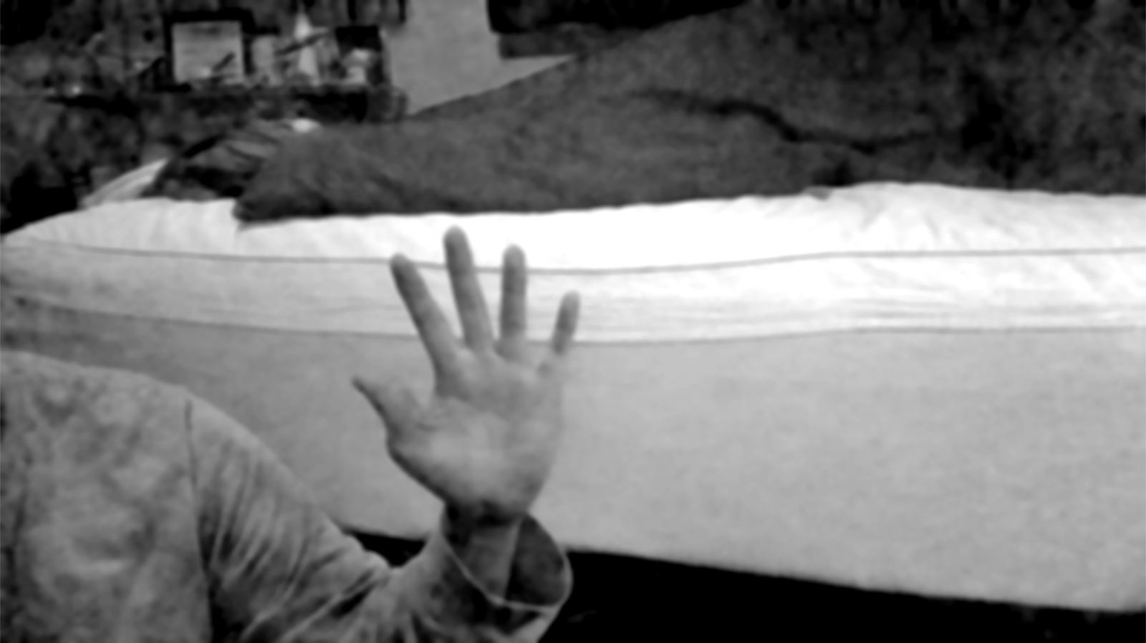
Prepping Images
Gaussian blur
Median blur
Blue channel greyscale

Slide 7
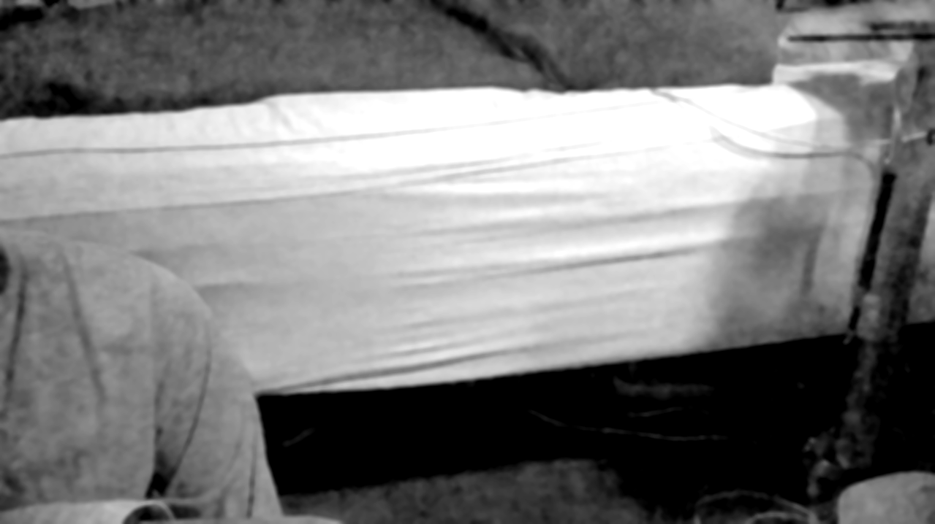
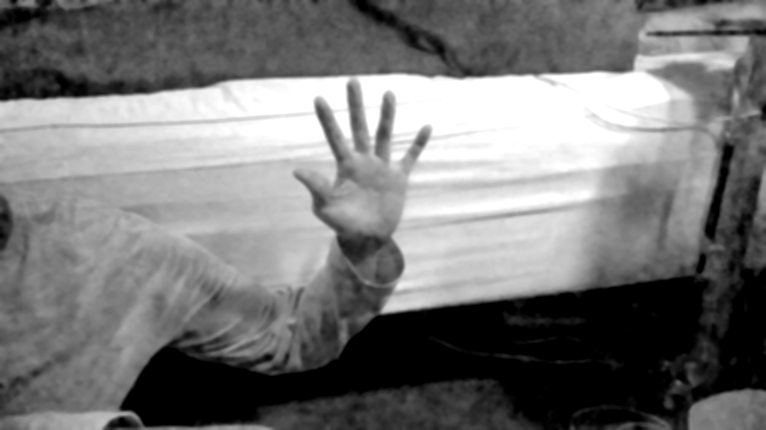
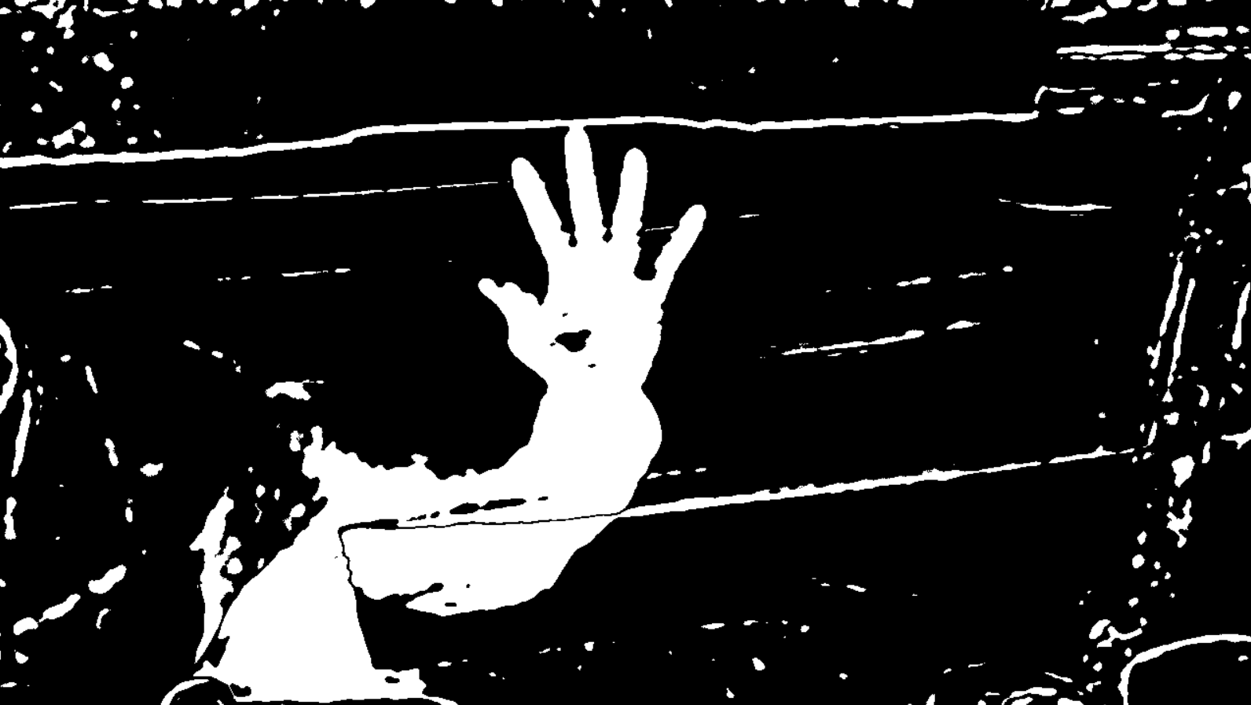
Removing Background From Frame
For every pixel in background
Find absolute difference between values
If pixels are similar then the output pixel will be black
If pixels are different then the output pixel will be white

Slide 8
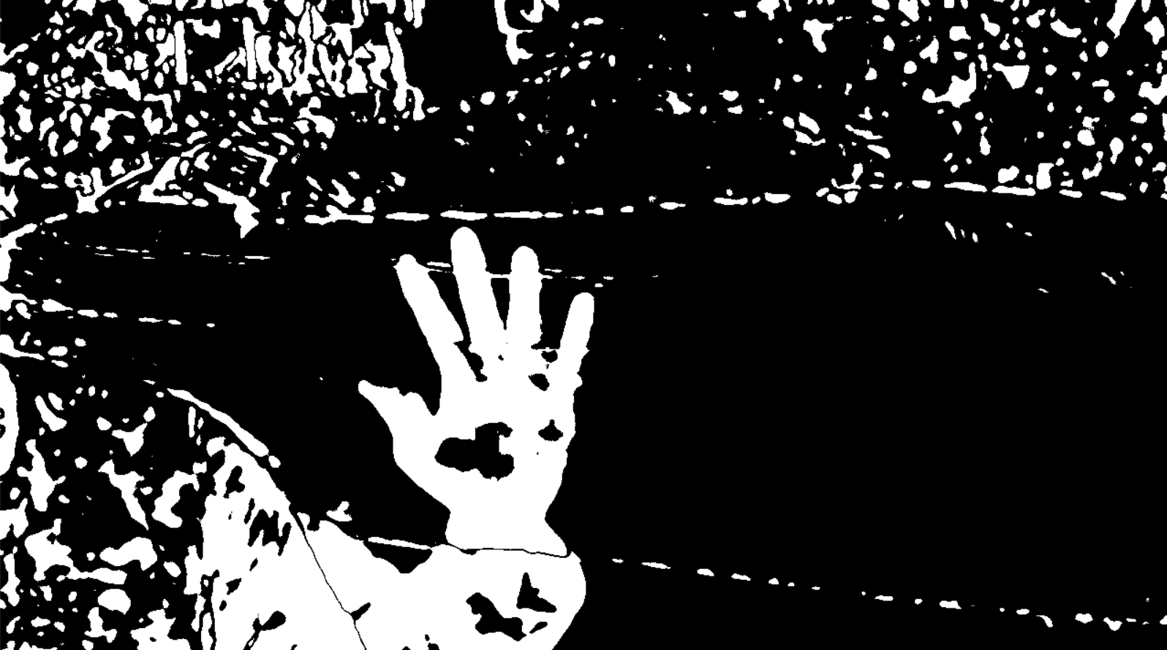
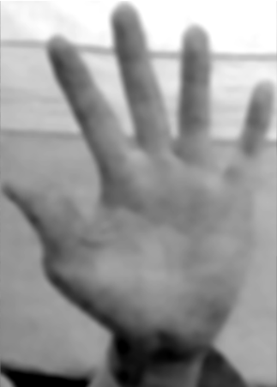
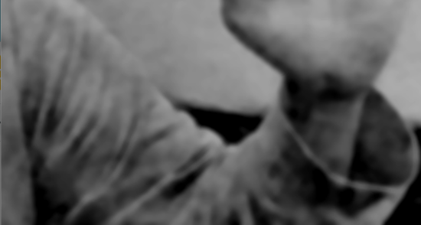
Contour Analysis
Find image contours
Sort vector of contours by largest area
Each significant contour represents a potential hand
Loop over all significant contours until hand is detected

Slide 9
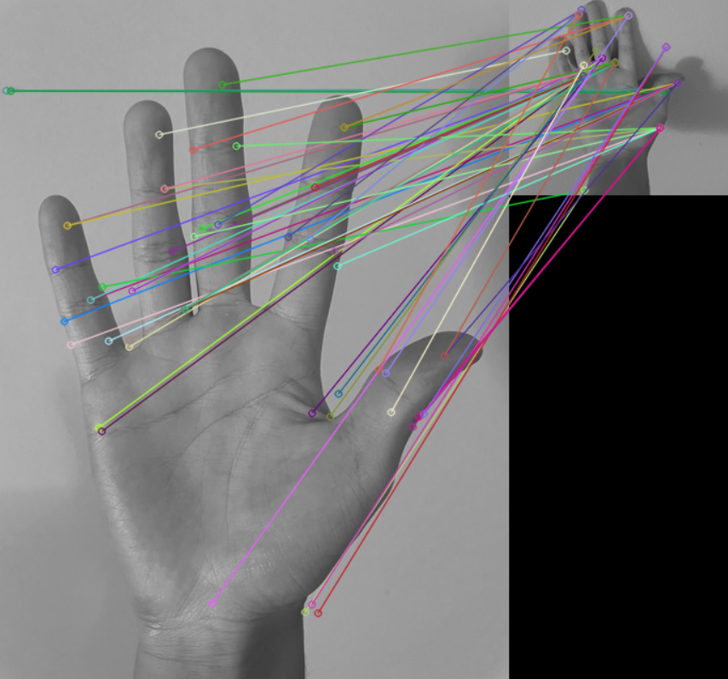
Templates and Feature-Based Matching
For every significant contour:
Loop through each hand template
Run feature-matching function for each
Get the best “match”
Return an int signifying hand position

Slide 10
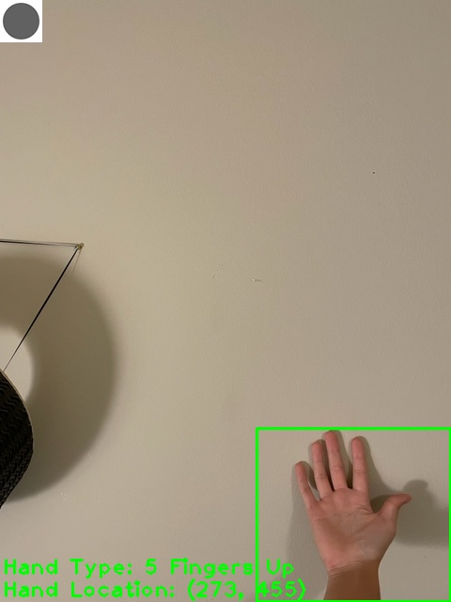



Printing Information
Rectangle around relative position of hand
Hand type
Hand location
Hand movement
Grey circle = Previous hand undetected
Red circle = Hand staying still
Arrow = Hand moving

